Slide 1





AI Risk Prediction for Bariatric Surgery
Group Bariatric Surgery G1
Notes:
Tobias Start

Slide 2
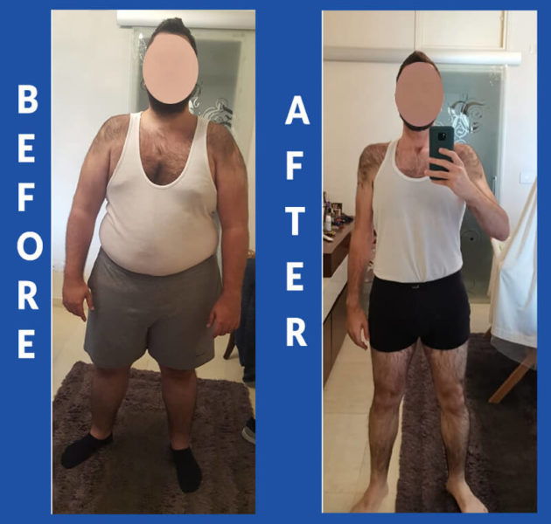
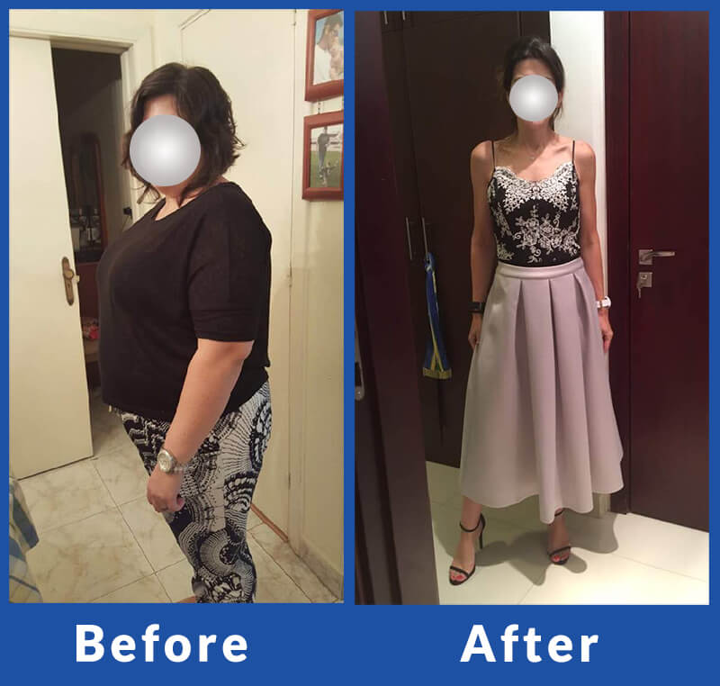
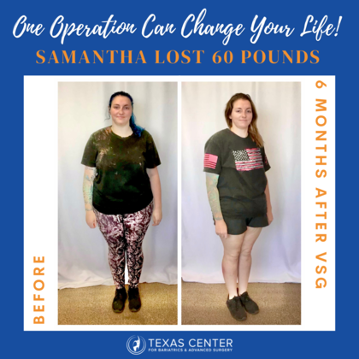
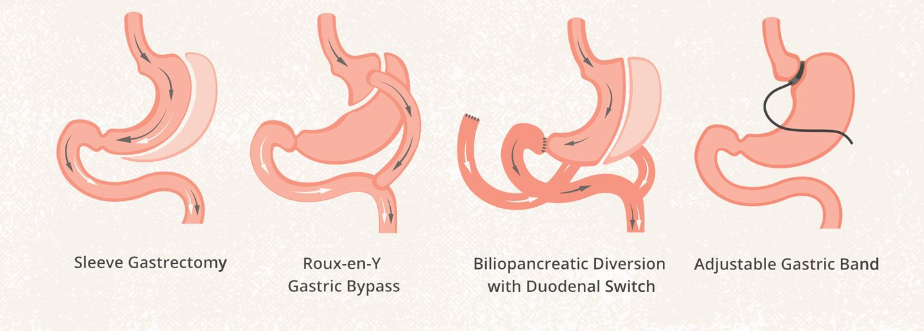
What is bariatric surgery?

Slide 3
The problem with bariatric surgeries

Slide 4

The problem with bariatric surgeries
South Africa: 23% overweight; 27% obese

Slide 5
The problem with bariatric surgeries
Not all patients benefit equally from the procedure
Some are more likely to receive future complications

Slide 6

The solution

Slide 7
The solution
Which patients face a high risk of
post-operative complications
Which patients are most likely to benefit
Notes:
Tobias End

Slide 8
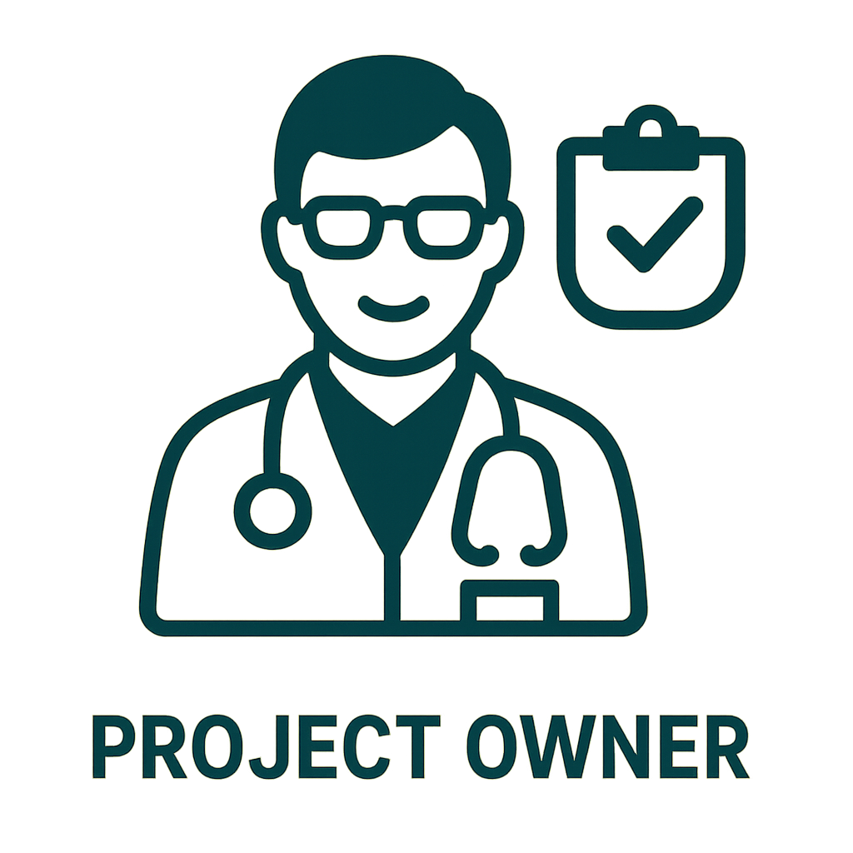



Team members:
Robin
Wout
Tobias
AI Model
AI Model
Interface
Notes:
Robin Start

Slide 9


Why?
Avoids unnecessary surgeries for high-risk patients
Saves operating room time
Saves staff effort
Lowers Equipment use
Reduces post-op complications
Fewer ICU stays
Fewer reoperations
Fewer extended hospitalizations
Lowers costs for patients while improving hospital efficiency

Slide 10


The current solution
Comorbidities
Weight
Height
BMI
This patient should undergo surgery!

Slide 11

The solution
Comorbidities
Weight
Height
BMI

Slide 12
The solution
Comorbidities
Weight
Height
BMI
High risk!
Prioritize non-surgical options first

Slide 13
What we have done
AI-model
Interface
Notes:
Robin End

Slide 14
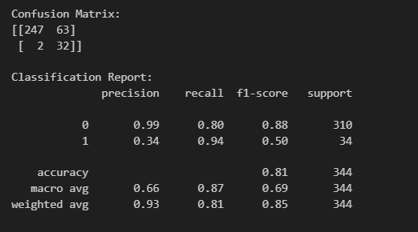
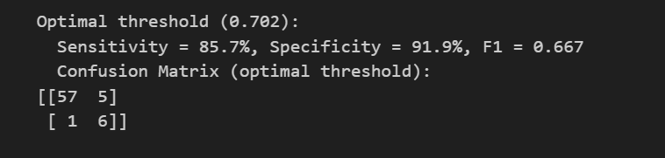
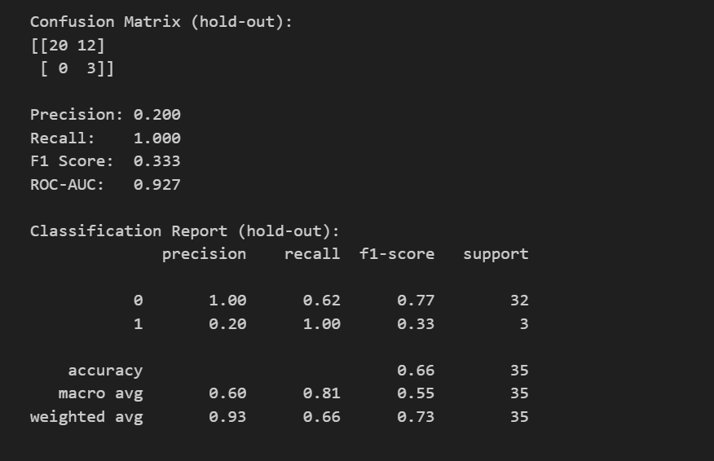
What we have done
Logistic Regression
XgBoost
Simple classifier
Advanced classifier
AI-model
Interface
Notes:
Wout Start/End

Slide 15
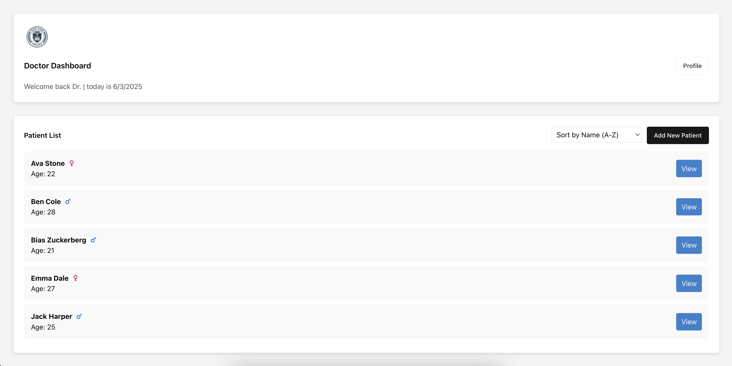
What we have done
AI-model
Interface
Notes:
Tobias Start

Slide 16
What we have done
AI-model
Interface

Slide 17
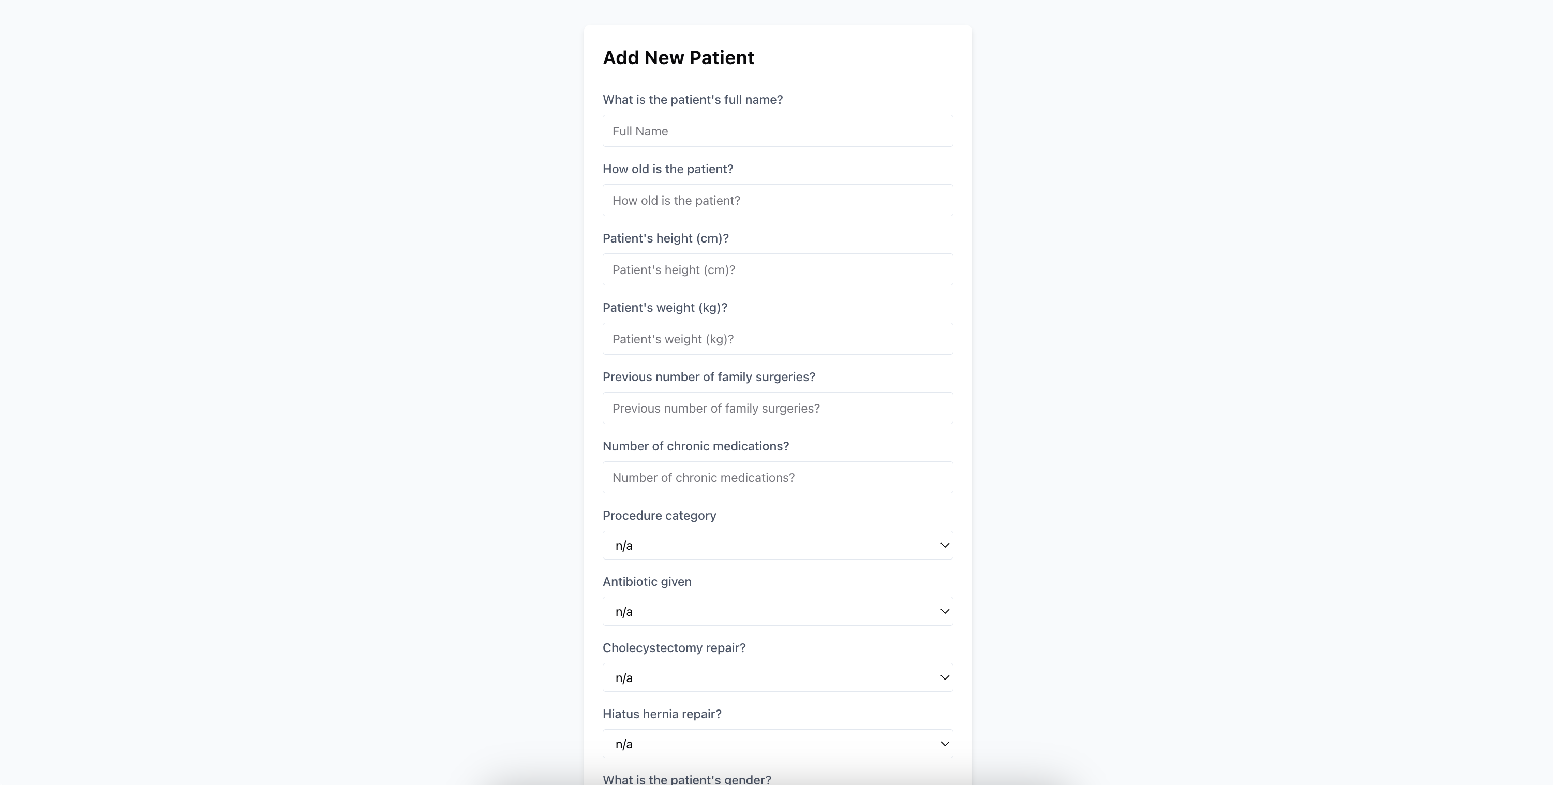
What we have done
AI-model
Interface

Slide 18
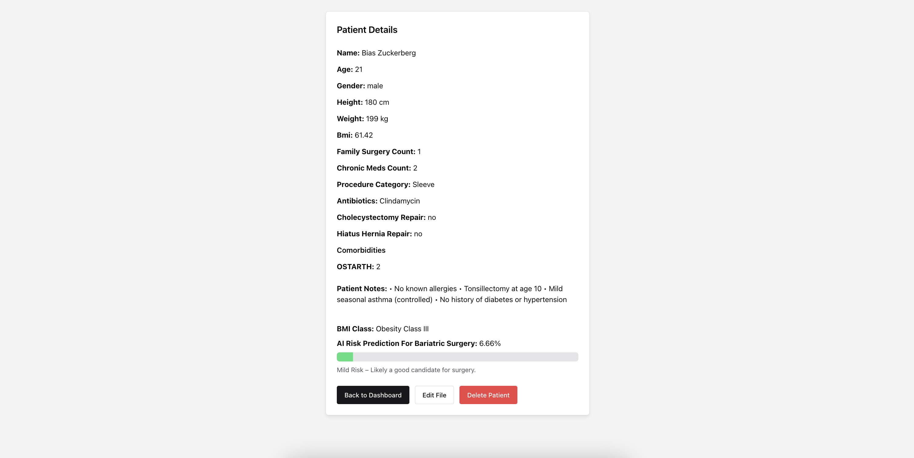
What we have done
AI-model
Interface

Slide 19
Demo
Notes:
Tobias End

Slide 20

Project Management
Notes:
Wout Start

Slide 21
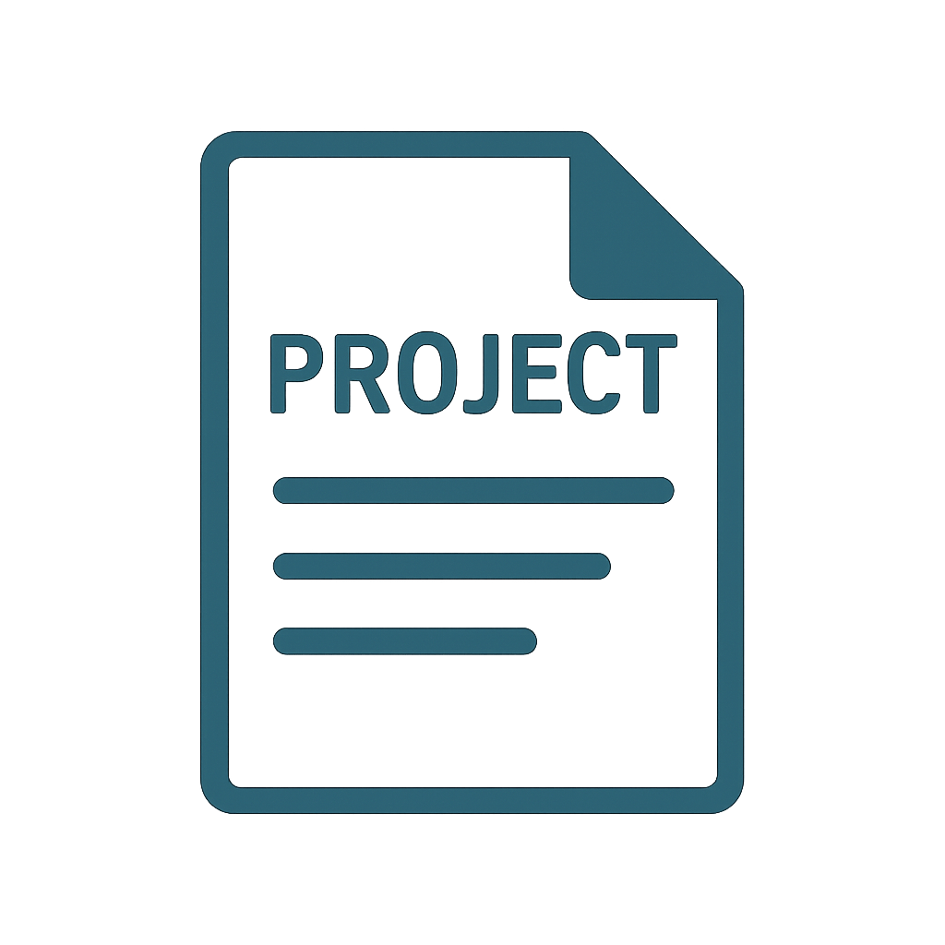
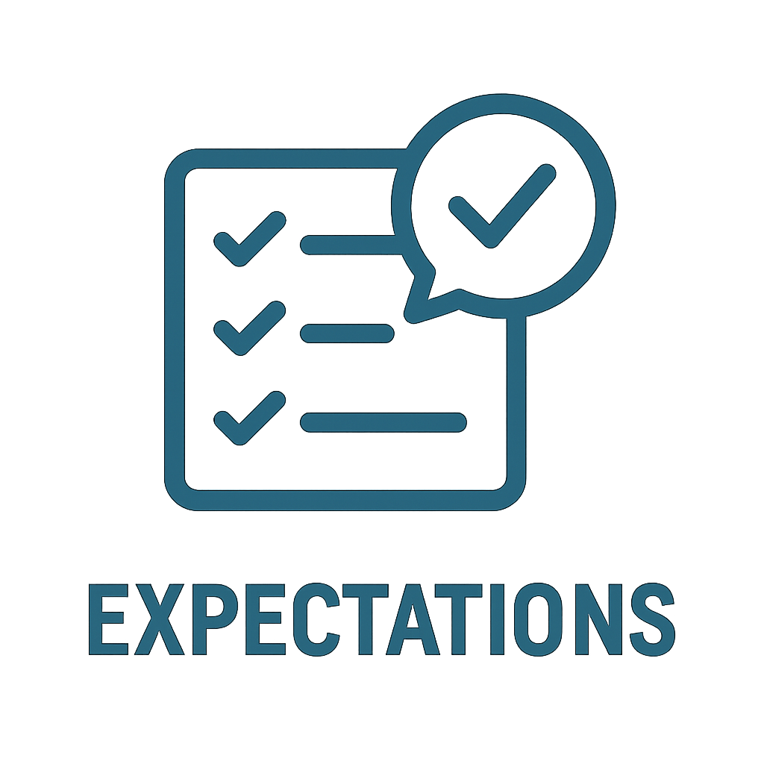
Project Management
1st client meeting
Dr. Breytenbach
General introduction to project
Access to historical surgery dataset
Overview of expectations
Try tradition methods first and compare
Web-based interface to predict patient’s risk
Notes:
In our first meeting with Dr. Breytenbach, we were introduced to the project: building AI-based risk prediction models for bariatric surgery patients in South Africa. This project is part of a larger effort to develop a national medical platform. We were given access to historical surgery data and tasked with predicting the likelihood of minor and major complications using traditional methods first, then comparing them to advanced models like neural networks. Dr. Breytenbach emphasized the need to justify any shift in approach and asked us to consider the user journey—from patients providing basic medical details to doctors receiving risk insights through a web interface that also prioritizes patient cases based on health features.

Slide 22
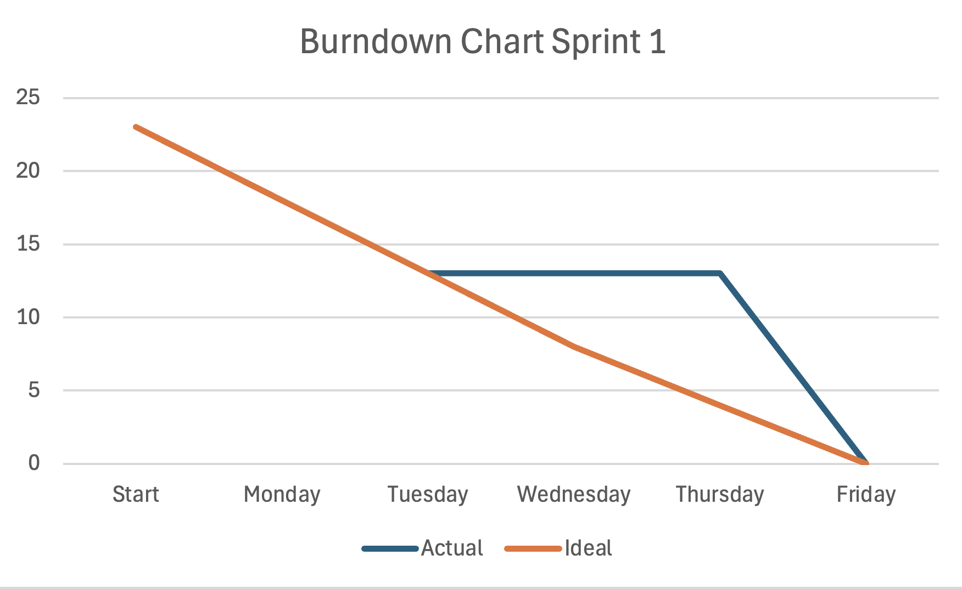
Project Management
Notes:
So we started by dividing tasks and story points which are basically representations of effort. For the first week we had divided around 23 story points for us 3 and we started working on them right after our first meeting Monday.
Setting up the github and Trello for instance. Wednesday and thursday we were travelling to South Africa and Friday we finished our setting up of the project.

Slide 23
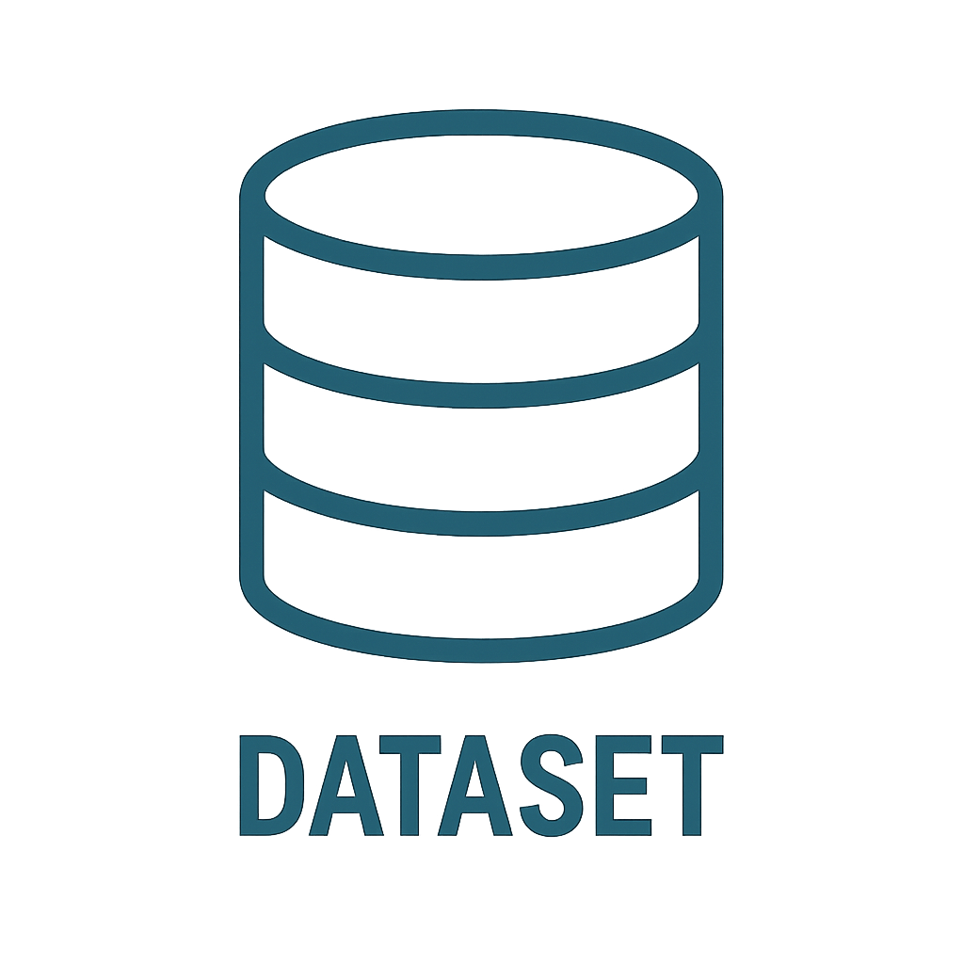

Project Management
2nd client meeting
Review of dataset
Removal of unnecessary data
Explanations of data types
Selection of most important features
Ready for model building
Notes:
In our second meeting with Dr. Breytenbach, we reviewed the dataset in more detail and discussed which features were relevant. He advised us to remove columns like hospital, anaesthetist, and doctor to avoid misleading correlations, and to clean up invalid or unrealistic values. We learned that complications are graded from 1 (minor) to 5 (morbid), though the most severe cases were excluded during anonymization. Dr. Breytenbach encouraged us to explore both pre-operative and post-operative prediction models, suggesting we add features like surgery duration and correct blood loss entries. With this feedback, we prepared to begin building our first proper models for discussion in the next meeting.

Slide 24
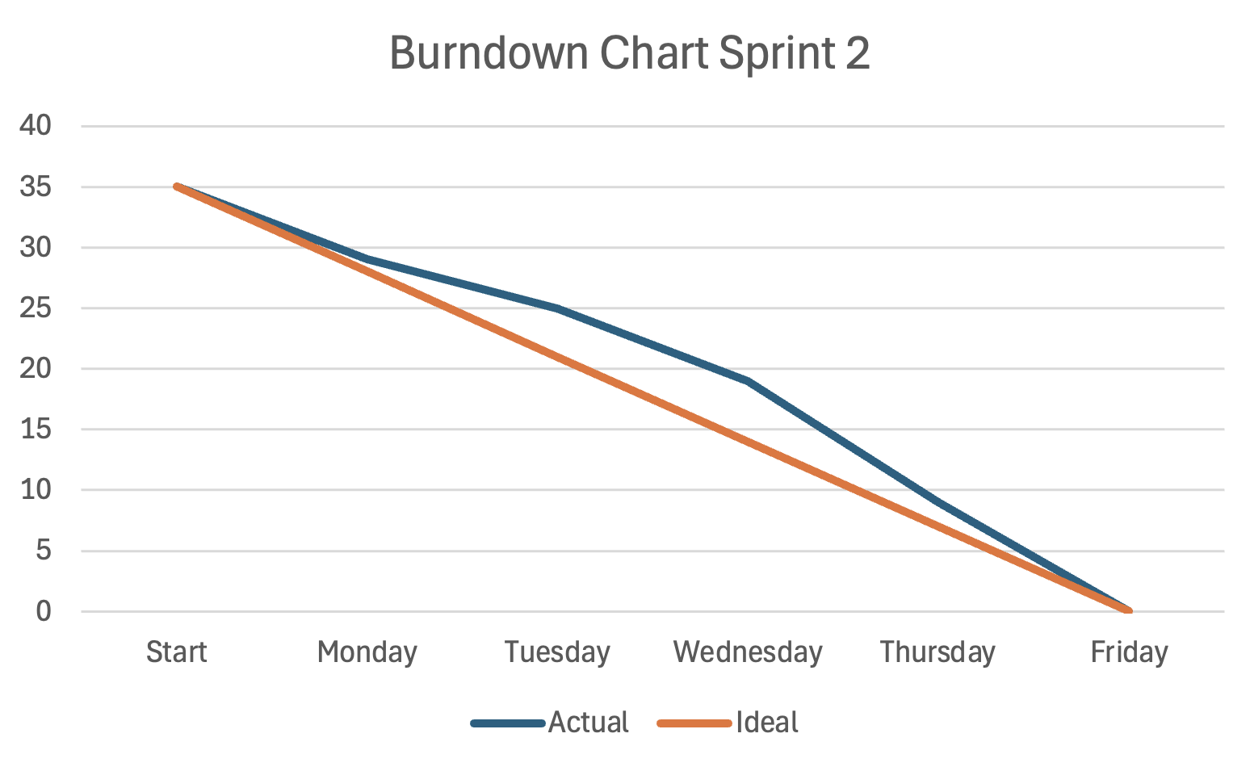
Project Management

Slide 25
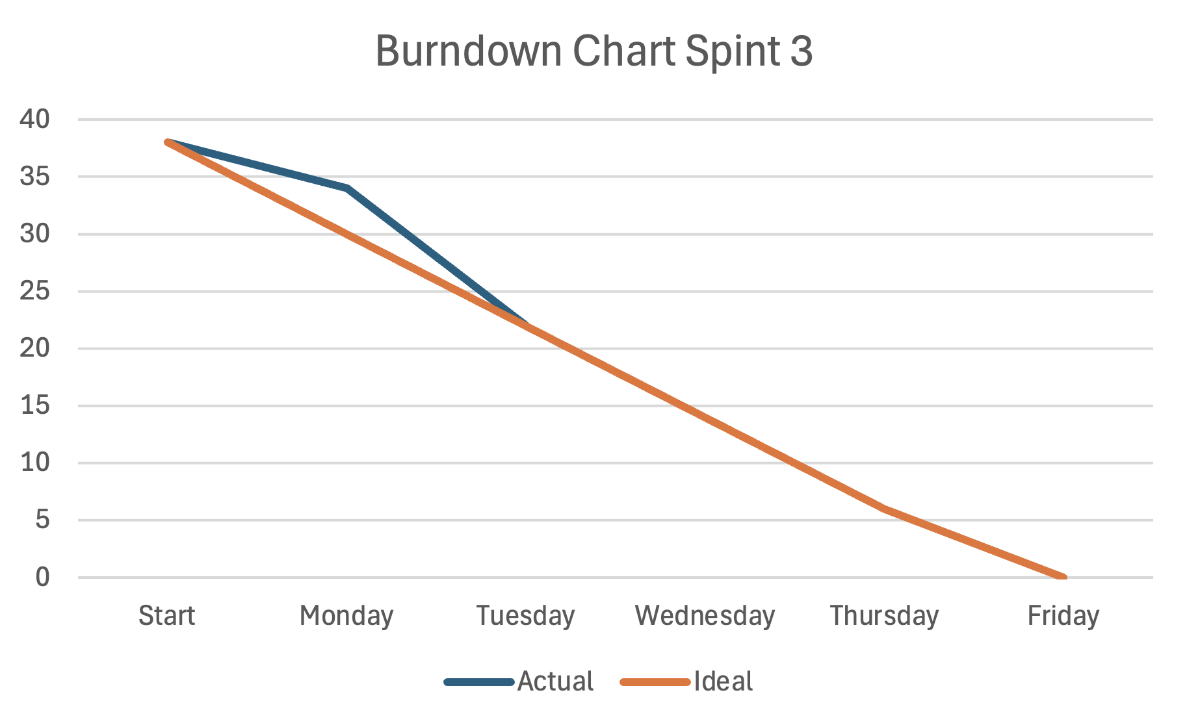
Project Management

Slide 26
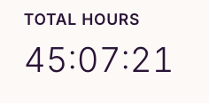
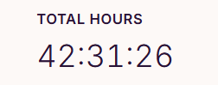
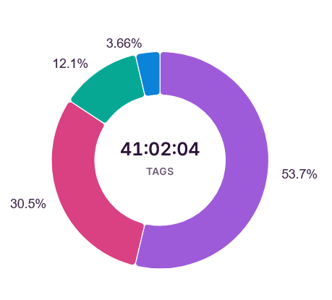
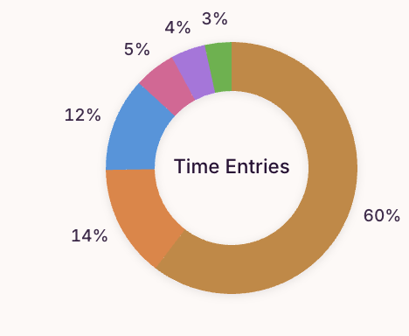
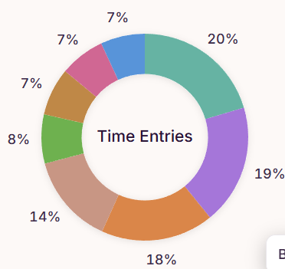
Time Management
Tobias
Robin
Wout
Deliverables
Deliverables
Meetings
Deliverables
Meetings
Meetings
Model
tuning
Analyzing
dataset
Feature
cleaning
Model
Building
Integrating
AI-Model
Interface
Data
science
Tuning
dataset
Training model
Model making
Notes:
Wout End

Slide 27
Retrospective
Notes:
Robin Start

Slide 28
Retrospective
Team
Trello could’ve been more organized sooner
Distribute tasks for every team member earlier
Project
Too little data
Unbalanced data
Miscorrelations between features

Slide 29
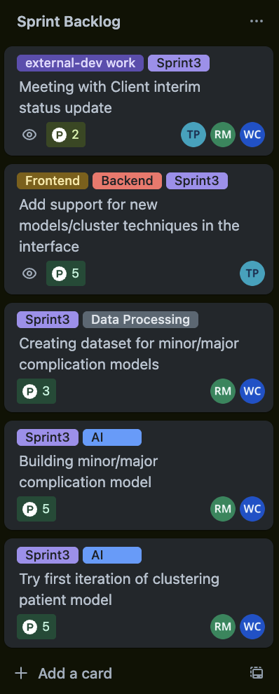


Looking Forward
Split data into minor/major complication classification
Try to cluster patients together and review if certain clusters/characteristics have higher risks

Slide 30
Thank you for listening!
Notes:
Robin End

